Slide 1
Transactions and Recovery
Database Systems Lecture 14
Natasha Alechina

Slide 2
In This Lecture
Transactions
Recovery
  System and Media Failures
Concurrency
  Concurrency problems
For more information
  Connolly and Begg chapter 20
  Ullman and Widom 8.6
Transactions and Recovery

Slide 3
Transactions
A transaction is an action, or a series of actions, carried out by a single user or an application program, which reads or updates the contents of a database.
Transactions and Recovery

Slide 4
Transactions
A transaction is a ‘logical unit of work’ on a database
  Each transaction does something in the database
  No part of it alone achieves anything of use or interest
Transactions are the unit of recovery, consistency, and integrity as well
ACID properties
  Atomicity
  Consistency
  Isolation
  Durability
Transactions and Recovery

Slide 5
Atomicity and Consistency
Atomicity
  Transactions are atomic – they don’t have parts (conceptually)
  can’t be executed partially; it should not be detectable that they interleave with another transaction
Consistency
  Transactions take the database from one consistent state into another
  In the middle of a transaction the database might not be consistent
Transactions and Recovery

Slide 6
Isolation and Durability
Isolation孤立状态
  The effects of a transaction are not visible to other transactions until it has completed
  From outside the transaction has either happened or not
  To me this actually sounds like a consequence of atomicity…
Durability持久性
  Once a transaction has completed, its changes are made permanent
  Even if the system crashes, the effects of a transaction must remain in place
Transactions and Recovery

Slide 7
Example of transaction
Transfer £50 from account A to account B
  Read(A)
  A = A - 50
  Write(A)
  Read(B)
  B = B+50
  Write(B)
  Atomicity - shouldn’t take money from A without giving it to B
  Consistency - money isn’t lost or gained
  Isolation - other queries shouldn’t see A or B change until completion
  Durability - the money does not go back to A
transaction
Transactions and Recovery

Slide 8
The Transaction Manager
The transaction manager enforces the ACID properties
  It schedules the operations of transactions
  COMMIT and ROLLBACK are used to ensure atomicity
  Locks or timestamps are used to ensure consistency and isolation for concurrent transactions (next lectures)
  A log is kept to ensure durability in the event of system failure (this lecture)
Transactions and Recovery

Slide 9
COMMIT and ROLLBACK
COMMIT signals the successful end of a transaction
  Any changes made by the transaction should be saved
  These changes are now visible to other transactions
ROLLBACK signals the unsuccessful end of a transaction
  Any changes made by the transaction should be undone
  It is now as if the transaction never existed
Transactions and Recovery

Slide 10
Recovery
Transactions should be durable, but we cannot prevent all sorts of failures:
  System crashes
  Power failures
  Disk crashes
  User mistakes
  Sabotage
  Natural disasters
Prevention is better than cure
  Reliable OS
  Security
  UPS （ Uninterrupted Power Supply），即不间断电源and surge protectors浪涌保护器
  RAID arrays
Can’t protect against everything though
Transactions and Recovery

Slide 11
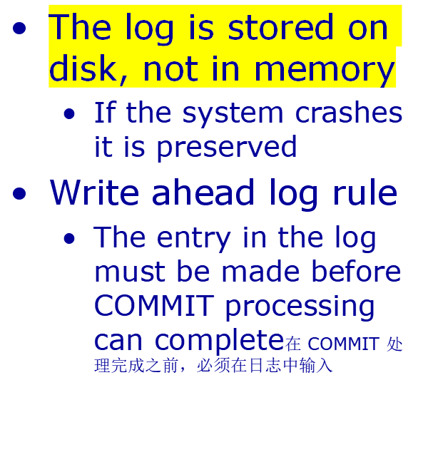
The Transaction Log
The transaction log records the details of all transactions
  Any changes the transaction makes to the database
  How to undo these changes
  When transactions complete and how
Transactions and Recovery

Slide 12
System Failures
A system failure means all running transactions are affected
  Software crashes
  Power failures
The physical media (disks) are not damaged
At various times a DBMS takes a checkpoint
  All committed transactions are written to disk
  A record is made (on disk) of the transactions that are currently running记录当前正在进行的事务
Transactions and Recovery

Slide 13
Types of Transactions
T₁
T₂
T₃
T₄
T₅
Last Checkpoint
System Failure
Transactions and Recovery

Slide 14
System Recovery
Any transaction that was running at the time of failure needs to be undone and restarted
Any transactions that committed since the last checkpoint need to be redone
Transactions of type T₁ need no recovery
Transactions of type T₃ or T₅ need to be undone and restarted
Transactions of type T₂ or T₄ need to be redone
Transactions and Recovery

Slide 15
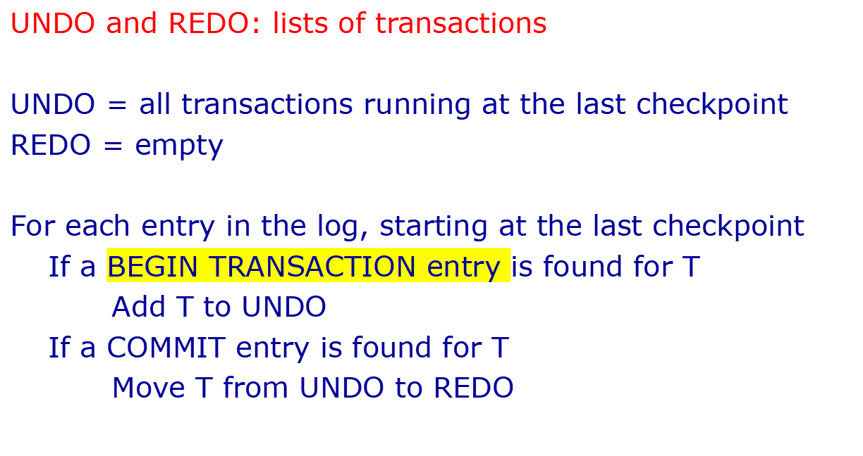
Transaction Recovery
Transactions and Recovery

Slide 16
Transaction Recovery
T₁
T₂
T₃
T₄
T₅
Checkpoint
Failure
UNDO: T₂, T₃
Last Checkpoint
Active transactions: T₂, T₃
REDO:
Transactions and Recovery

Slide 17
Transaction Recovery
T₁
T₂
T₃
T₄
T₅
Checkpoint
Failure
UNDO: T₂, T₃, T₄
T4 Begins
Add T₄ to UNDO
REDO:
Transactions and Recovery

Slide 18
Transaction Recovery
T₁
T₂
T₃
T₄
T₅
Checkpoint
Failure
UNDO: T₂, T₃, T₄, T₅
T₅ begins
Add T₅ to UNDO
REDO:
Transactions and Recovery

Slide 19
Transaction Recovery
T₁
T₂
T₃
T₄
T₅
Checkpoint
Failure
UNDO: T₃, T₄, T₅
T2commit了，把它放在redo集合
T₂ Commits
Move T₂ to REDO
REDO: T₂
Transactions and Recovery

Slide 20
Transaction Recovery
T₁
T3跨越了checkpoint',所以，在failure的时候一定要undo。
T5未跳跃checkpoint不做undo
T₂
T₃
T₄
T₅
Checkpoint
Failure
在checkpoint将T2，T3内容先写入硬盘一部分，将T1内容全部写入硬盘
UNDO: T₃, T₅
T₄ Commits
Move T₄ to REDO
REDO: T₂, T₄
由于T1在checkpoint前结束，所以就将它的log删掉了
Transactions and Recovery

Slide 21
Forwards and Backwards
Backwards recovery
  We need to undo some transactions
  Working backwards through the log we undo any operation by a transaction on the UNDO list通过日志向后工作，我们通过 UNDO 列表中的事务撤消任何操作
  This returns the database to a consistent state
Forwards recovery
  Some transactions need to be redone
  Working forwards through the log we redo any operation by a transaction on the REDO list
  This brings the database up to date
Transactions and Recovery

Slide 22
Media Failures
System failures are not too severe
  Only information since the last checkpoint is affected仅影响自上次检查点以来的信息
  This can be recovered from the transaction log
Media failures (disk crashes etc) are more serious
  The data stored to disk is damaged
  The transaction log itself may be damaged
Transactions and Recovery

Slide 23
Backups备份
Backups备份 are needed to recover from media failure
  The transaction log and entire contents of the database is written to secondary storage (often tape)数据库的事务日志和全部内容被写入辅助存储
  Time consuming, and often requires down time耗时，通常需要停机时间（什么意思）
Backups frequency
  Frequent enough that little information is lost
  Not so frequent as to cause problems
  Every day (night) is common
Backup storage
Transactions and Recovery

Slide 24
Recovery from Media Failure
Restore the database from the last backup
Use the transaction log to redo any changes made since the last backup
If the transaction log is damaged you can’t do step 2
  Store the log on a separate physical device to the database将日志存储在单独的物理设备上到数据库（啥意思？）
  The risk of losing both is then reduced失去两者的风险就会降低
Transactions and Recovery

Slide 25
Concurrency并发
Large databases are used by many people
  Many transactions to be run on the database
  It is desirable to let them run at the same time as each other
  Need to preserve isolation
If we don’t allow for concurrency then transactions are run sequentially
  Have a queue of transactions
  Long transactions (eg backups) will make others wait for long periods
Transactions and Recovery

Slide 26
Concurrency Problems
In order to run transactions concurrently we interleave交织 their operations
Each transaction gets a share of the computing time
This leads to several sorts of problems
  Lost updates
  Uncommitted updates
  Incorrect analysis
All arise because isolation is broken
Transactions and Recovery

Slide 27
Lost Update
T1 and T2 read X, both modify it, then both write it out
  The net effect of T1 and T2 should be no change on X
  Only T2’s change is seen, however, so the final value of X has increased by 5
T1 T2
Read(X)
X = X - 5
Read(X)
X = X + 5
Write(X)
Write(X)
COMMIT
COMMIT
Transactions and Recovery

Slide 28
Uncommitted Update
T2 sees the change to X made by T1, but T1 is rolled back
  The change made by T1 is undone on rollback
  It should be as if that change never happened
T1 T2
Read(X)
X = X - 5
Write(X)
Read(X)
X = X + 5
Write(X)
ROLLBACK
COMMIT
Transactions and Recovery

Slide 29
Inconsistent analysis
T1 doesn’t change the sum of X and Y, but T2 sees a change
  T1 consists of two parts – take 5 from X and then add 5 to Y
  T2 sees the effect of the first, but not the second
T1 T2
Read(X)
X = X - 5
Write(X)
Read(X)
Read(Y)
Sum = X+Y
Read(Y)
Y = Y + 5
Write(Y)
Transactions and Recovery

Slide 30
Next Lecture
Concurrency
  Locks and resources
  Deadlock
Serialisability
  Schedules of transactions
  Serial & serialisable schedules
For more information
  Connolly and Begg chapter 20
  Ullman and Widom 8.6
Transactions and Recovery

